Slide 1
Review
Pointer
Pointer Variables
Dynamic Memory Allocation
Functions

Slide 2
Arrays & Strings
Array
Array Elements
Accessing array elements
Declaring an array
Initializing an array
Two-dimensional Array
Array of Structure
String
Array of Strings
Examples

Slide 3
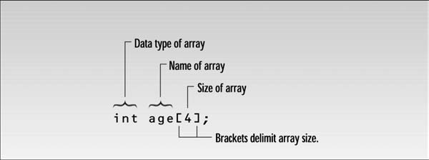
Introduction
Arrays
Contain fixed number of elements of same data type
Static entity- same size throughout the program
An array must be defined before it is used
An array definition specifies a variable type, a name and size
Size specifies how many data items the array will contain
An example

Slide 4
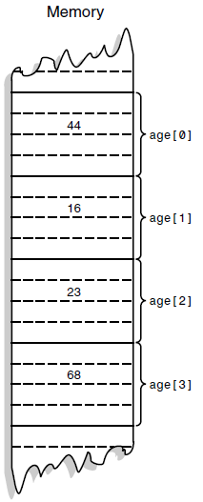
Array Elements
The items in an array are called elements
All the elements are of the same type
The first array element is numbered 0
Four elements (0-3) are stored consecutively in
the memory

Slide 5
Accessing array elements
To access an element specify array name and array index number
Syntax:
arrayname[ arrayindex]
to access 3rd element of array age we use
age[2] age is the name of the array and 2 is the index number

Slide 6
Declaring an array
when declaring an array, specify
type of array
array name
number of elements
arrayType arrayName [ numberofElements ]
examples
int results [10 ];
float myArray [50];
declaring multiple arrays of same type
format similar to regular variables
example: int b[5], x[10];

Slide 7
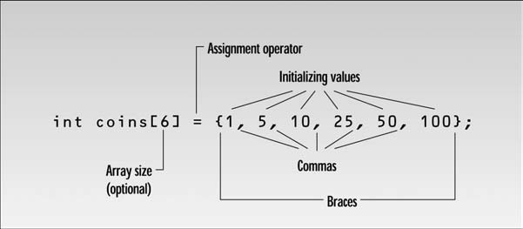
Initializing an array
when an array is defined then you can give values to each array elements
example:
int n[5]={1,2,3,4,5};

Slide 8
if not enough initializing values, then the rightmost elements become 0
example: int n[5]={1,2,3}; same as int n[5]={1,2,3,0,0};
if int n[5]={0} then all elements are 0
if size of an array is less than the values assigned to elements then it is a syntax error
if size of an array is not specified, then compiler determines it from the initializing values
we don’t need to use array size when we initialize all the array elements
example: int n[ ]={1,2,3,4,5};

Slide 9
Array example
#include <iostream>
int main ()
{
int bills [] = {16, 2, 77, 40, 12071};
int n, result=0;
for ( n=0 ; n<5 ; n++ )
{
result += bills[n];
}
cout << result;
return 0;
}

Slide 10
Two-dimensional Array
one-dimensional array: a single variable specifies each array elements
but arrays can be defined as two-dimensional
array of arrays is called multidimensional array
all the elements are of the same data type
example: int anArray[3][5];
a two dimensional array
first subscript as being the row, the second as column
so this array contains 3 rows and 5 columns
[0][0] [0][1] [0][2] [0][3] [0][4]
[1][0] [1][1] [1][2] [1][3] [1][4]
[2][0] [2][1] [2][2] [2][3] [2][4]

Slide 11
Defining two-dimensional array
two dimensional array is defined with two size specifier, each enclosed in brackets
example: double sales[DISTRICTS] [MONTHS]
sales is a two dimensional array of arrays
it is an array of DISTRICTS elements, each of which is an array of MONTHS elements

Slide 12
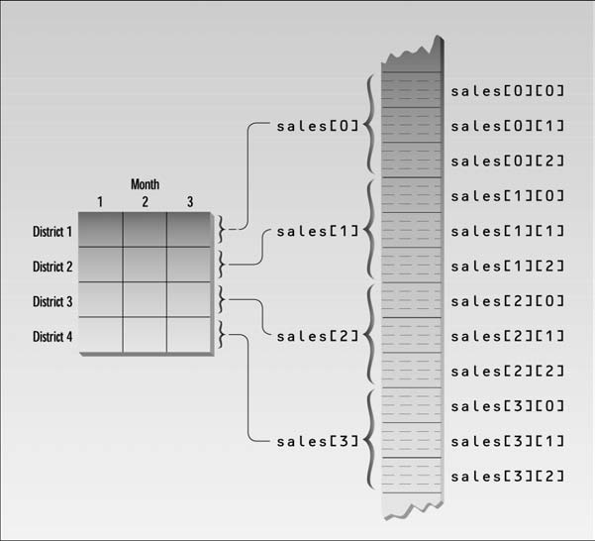
two-dimensional array

Slide 13
Accessing two-dimensional array
to access the two-dimensional array elements, use two indexes
sales [d] [m]; note that each index has its own set of brackets
sales [d,m]; doesn’t work
example:
x=sales[3][2];
it means that assign the value of 4th row and 3rd column to variable x

Slide 14
Initializing two-dimensional array
to initialize a two-dimensional array, it is easy to use nested braces with each set of numbers representing a row
the initializing values for each subarray are enclosed in braces and separated by commas
example:
int anArray[3][5] =
{
{ 1, 2, 3, 4, 5, }, // row 0 with 5 cols
{ 6, 7, 8, 9, 10, }, // row 1
{ 11, 12, 13, 14, 15 } // row 2
};

Slide 15
cont…
two-dimensional arrays with initializer can only omit the first index number
the compiler can find out the array size
example:
int anArray[][5] =
{
{ 1, 2, 3, 4, 5, },
{ 6, 7, 8, 9, 10, },
{ 11, 12, 13, 14, 15 }
};

Slide 16
cont…
you cannot omit both indexes
example:
int anArray[][] =
{
{ 1, 2, 3, 4 },
{ 5, 6, 7, 8 }
};
the inner parenthesis are ignored and the compiler cannot identify whether you want to declare 1x8, 2x4,4x2,8x1 array in this case
just like normal array, two-dimensional array can be initialized to 0
e.g. int anArray[3][5]={0};
this only works if you declare explicitly the size of an array otherwise you will get a two dimensional array with 1 row

Slide 17
cont…
accessing all of the elements of two-dimensional array requires two loops: one for the row, and one for the column
typically a two-dimensional array is accessed row by row, generally the row index is used as outer loop
example:
for (int nRow = 0; nRow < nNumRows; nRow++)
for (int nCol = 0; nCol < nNumCols; nCol++)
cout << anArray[nRow][nCol];

Slide 18
Passing arrays to functions
arrays can be used as arguments to functions
in C++ it is not possible to pass a complete block of memory by value as a parameter to a function
we are allowed to pass its address
example: to pass an array to a function, declare as
int myArray[10];
procedure(myArray);

Slide 19
Function declaration with array arguments
in a function declaration, array arguments are represented by the data type and size of the array
example:
void display( float[DISTRICTS][MONTHS] ); // declaration
or we can also declare it as follow
void display( float [][MONTHS] ); // declaration
if we are declaring a function that use a one-dimensional array as an argument, we don’t need to use the array size
example:
void somefunc( int elem[] ); // declaration

Slide 20
an example
// arrays as parameters
#include <iostream>
void printarray (int arg[], int length)
{
for (int n=0; n<length; n++)
cout << arg[n] << " ";
cout << "\n";
}
int main ()
{
int firstarray[] = {5, 10, 15};
int secondarray[] = {2, 4, 6, 8, 10};
printarray (firstarray,3);
printarray (secondarray,5);
return 0;
}

Slide 21
Arrays of Structures
arrays can contain data types as well as structures
example:
int main()
{
int n;
const int SIZE=2;
struct part //specify a structure
{
int modelnumber;
int partnumber;
float cost;
};
part apart[SIZE]; //define array of structure

Slide 22
cont…
for(n=0; n<SIZE; n++) //get values for all members
{
cout << endl;
cout << “Enter model number: “;
cin >> apart[n].modelnumber; //get model number
cout << “Enter part number: “;
cin >> apart [n].partnumber; //get part number
cout << “Enter cost: “;
cin >> apart [n].cost; //get cost
}
for(n=0; n<SIZE; n++) //show values for all members
{
cout << “Model “ << apart[n].modelnumber;
cout << “ Part “ << apart[n].partnumber;
cout << “ Cost “ << apart[n].cost << endl;
}
return 0;
}

Slide 23
cont…
user types in model number, part number and cost of a part
the program records this data in a structure
the array of structure is defined in the statement
part apart[SIZE];
this is the same syntax as that of a simple data types
only the type name part shows that this is an array of more complex data types

Slide 24
Accessing a data item
accessing a data item that is a member of a structure that is itself an element of an array involves a new syntax
example:
apart[n].modelnumber
refers to the modelnumber member of the structure that is element n of the apart array

Slide 25
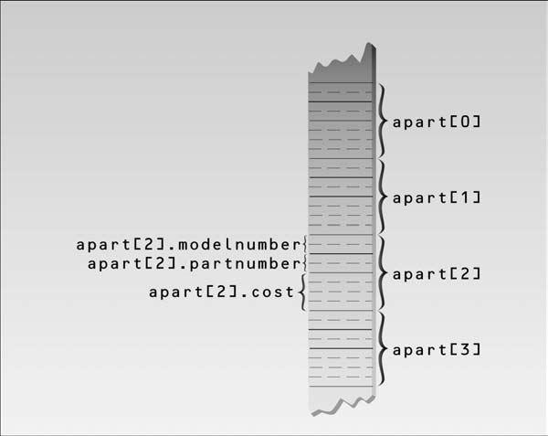

Slide 26
array of structures are a useful data type
it can be used in array of car parts, array of personal data (name, age, salary), geographical data about cities (name, population and elevation) and many other types of data

Slide 27
Strings
two types of strings are used in C++
C-Strings and strings that are object of the String class
we will study C-Strings only
C-Strings or C-Style String

Slide 28
an example
#include <iostream>
int main()
{
const int MAX = 80; //max characters in string
char str[MAX];
cout << “Enter a string: “;
cin >> str; //put string in str
//display string from str
cout << “You entered: “ << str << endl;
return 0;
}

Slide 29
the definition of the string variable looks like the definition of an array of type char
char str[MAX];
we read a string from the keyboard and place it in the string variable str
the extraction operator >> knows how to deal with strings
if the user enters a string “Amanuensis”, it will look like

Slide 30
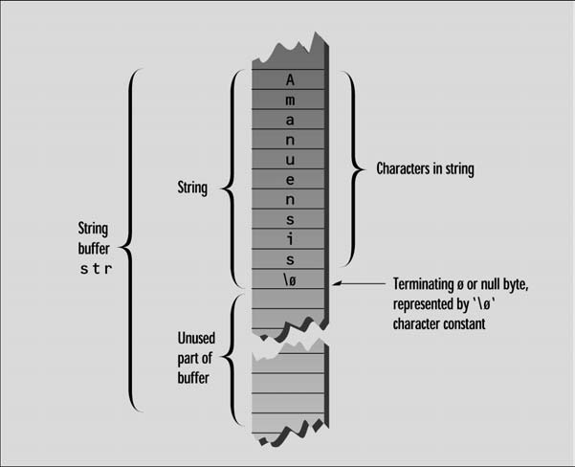

Slide 31
each character occupies 1 byte of memory
C-Strings must terminate with a byte containing 0
it is often represented by a character constant “\0” which is character with an ASCII value of 0
this terminating zero is called “Null character”
when the operator << displays a string, it displays characters until it encounters the null character

Slide 32
Avoiding Buffer Overflow
a program invites the user to type in a string
what if the user enters a string longer than the array size?
there is no mechanism in C++ for this case
however it is possible to tell >> operator to limit the number of characters it places in an array
we can use the setw manipulator to specify the maximum number of characters the input buffer can accept
the user may type more characters but the >> operator won’t insert them into the array
always enter one character less than the specified size, so that there is room for null character

Slide 33
#include <iostream.h>
#include <iomanip.h> //for setw
int main()
{
const int MAX = 20; //max characters in string
char str[MAX]; //string variable str
cout << “\nEnter a string: “;
cin >> setw(MAX) >> str; //put string in str,
// no more than MAX chars
cout << “You entered: “ << str << endl;
return 0;
}

Slide 34
String Constant
you can initialize a string to a constant value
#include <iostream.h>
int main()
{
char str[] = “Programming is fun.”;
//char str[] ={‘P’,’r’,’o’,’g’,’r’……};
cout << str << endl;
return 0;
}
a string constant is written as a normal English phrase

Slide 35
Reading embedded blanks
if you try to enter strings with more than one word, you may get surprised
Enter a string: Programming is fun.
You entered: Programming
the >> extraction operator considers a space to be a terminating character
it read strings consisting of a single word, anything typed after is thrown away
to read strings containing blanks, we use cin.get() function
a member function get() of which cin is an object

Slide 36
an example
#include <iostream.h>
int main()
{
const int MAX = 80; //max characters in string
char str[MAX]; //string variable str
cout << “\nEnter a string: “;
cin.get(str, MAX); //put string in str
cout << “You entered: “ << str << endl;
return 0;
}

Slide 37
cin.get(str, MAX);
the first argument is the array address where the string being input will be placed
the second argument specifies the maximum size of the array
with this function now we can store a string having more than one word
Enter a string: Programming is fun.
You entered: Programming is fun.

Slide 38
Reading Multiple Lines
what if we want to read multiple lines?
we use a third argument in cin.get() to solve this problem
this argument specifies the character that tells the function to stop reading
the default value for this argument is “\n” or newline
but if you call this function with some other character, the default will be overridden with the specified one

Slide 39
an example
#include <iostream.h>
const int MAX = 2000; //max characters in string
char str[MAX]; //string variable str
int main()
{
cout << “\nEnter a string:\n”;
cin.get(str, MAX, ‘$’); //terminate with $
cout << “You entered:\n” << str << endl;
return 0;
}
the function will accept the characters until you enter the terminating character “$” or you exceed the size of the array

Slide 40
Copying a string the hard way
this method deals with the strings character by character
#include <iostream.h>
#include <cstring.h> //for strlen()
int main()
{ //initialized string
char str1[] = “We are studying Algorithms and Data Structures”;
const int MAX = 80; //size of str2 buffer
char str2[MAX]; //empty string
for(int j=0; j<strlen(str1); j++) //copy strlen characters
str2[j] = str1[j]; // from str1 to str2
str2[j] = ‘\0’; //insert NULL at end
cout << str2 << endl; //display str2
return 0;
}

Slide 41
copying a string the easy way
if you don’t want to use a loop, there is a library function strcpy() which will do it for you
strcpy(destination, source)
#include <iostream.h>
#include <cstring.h> //for strcpy()
int main()
{
char str1[] = “We are studying Algorithms and Data Structures”;
const int MAX = 80; //size of str2 buffer
char str2[MAX]; //empty string
strcpy(str2, str1); //copy str1 to str2
cout << str2 << endl; //display str2
return 0;
}

Slide 42
Arrays of Strings
we can have arrays of strings as well
#include <iostream.h>
int main()
{
const int DAYS = 7; //number of strings in array
const int MAX = 10; //maximum size of each string
//array of strings
char star[DAYS][MAX] = { “Sunday”, “Monday”, “Tuesday”,“Wednesday”, “Thursday”,“Friday”, “Saturday” };
for(int j=0; j<DAYS; j++) //display every string
cout << star[j] << endl;
return 0;
}

Slide 43
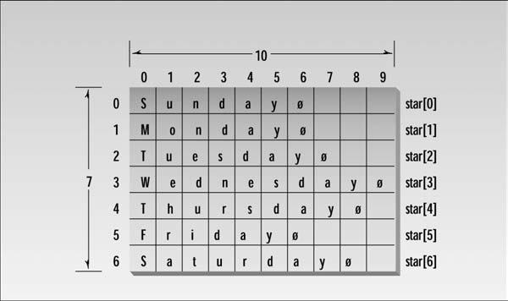

Slide 44
Summary
Array
Array Elements
Accessing array elements
Declaring an array
Initializing an array
Two-dimensional Array
Array of Structure
String
Array of Strings
Examples

